Slide 1
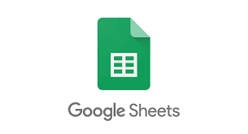
GOOGLE SHEETS

Slide 2
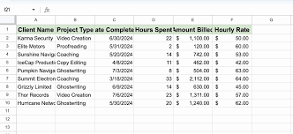
Google Sheets is a free online spreadsheet tool created by Google. It works like Microsoft Excel but runs in a web browser, allowing you to create, edit, and share spreadsheets from any device with internet access.

Slide 3
Key Features of Google Sheets
1. Cloud-Based & Auto-Save
No need to install software – it works online in your browser.
Automatically saves your work in Google Drive, preventing data loss.
Accessible from any device (PC, phone, or tablet).
2. Real-Time Collaboration
Multiple people can work on the same spreadsheet at the same time.
You can see changes live and chat with collaborators.
Add comments or use suggesting mode for teamwork.

Slide 4
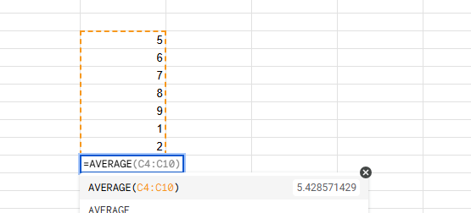
FUNCTIONS AND FORMULAS
Supports basic and advanced formulas, just like Excel.
Common functions:
SUM(A1:A10) → Adds numbers in a range.
AVERAGE(A1:A10) → Finds the average.
IF(A1>50, "Pass", "Fail") → Applies a condition.
VLOOKUP(101, A2:B10, 2, FALSE) → Finds data from a table.

Slide 5
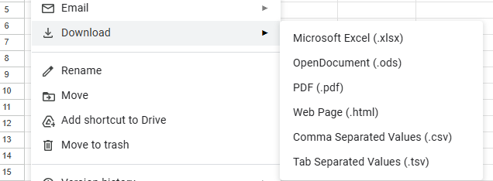
DATA ANALYSIS
Use Sorting & Filtering to organize data.
Create charts and graphs to visualize information.
Use Pivot Tables for advanced data analysis.
Import & Export Options
Open Excel files (.xlsx) in Google Sheets.
Download files as Excel (.xlsx), PDF, CSV, and more.

Slide 6
Add-ons & Google Integrations
Connect with Google Forms, Google Docs, and Google Drive.
Use Google Apps Scripts for automation.
Install Add-ons to enhance functionality.
Offline Access
Enable Offline Mode to work without the internet.
Changes will sync once you're back online.

Slide 7
HOW TO USE IT?
Step 1: Open Google Sheets
Go to sheets.google.com.
Click Blank to create a new spreadsheet.
Step 2: Enter & Format Data
Click a cell and type text or numbers.
Use bold, colors, and borders to format cells.

Slide 8
Step 3: Use Formulas & Functions
Click a cell and type = to start a formula.
Example: =SUM(A1:A5) to add numbers in cells A1 to A5.
Step 4: Share & Collaborate
Click Share (top-right corner).
Enter emails or create a shareable link.
Set permissions: Viewer, Commenter, or Editor.
Step 5: Save & Export
Click File > Download to save as Excel, PDF, or CSV.

Slide 9
Why Use Google Sheets?
Free & Cloud-Based – No installation needed. Auto-Save – Prevents data loss. Easy Collaboration – Work with others in real time. Works on Any Device – Accessible from phone, tablet, or computer. Excel Compatibility – Open and edit Excel files.

